Slide 1
R.Pavithra Guru
Asst.Prof.
Department of CSE
SRMIST-Ramapuram

Slide 2
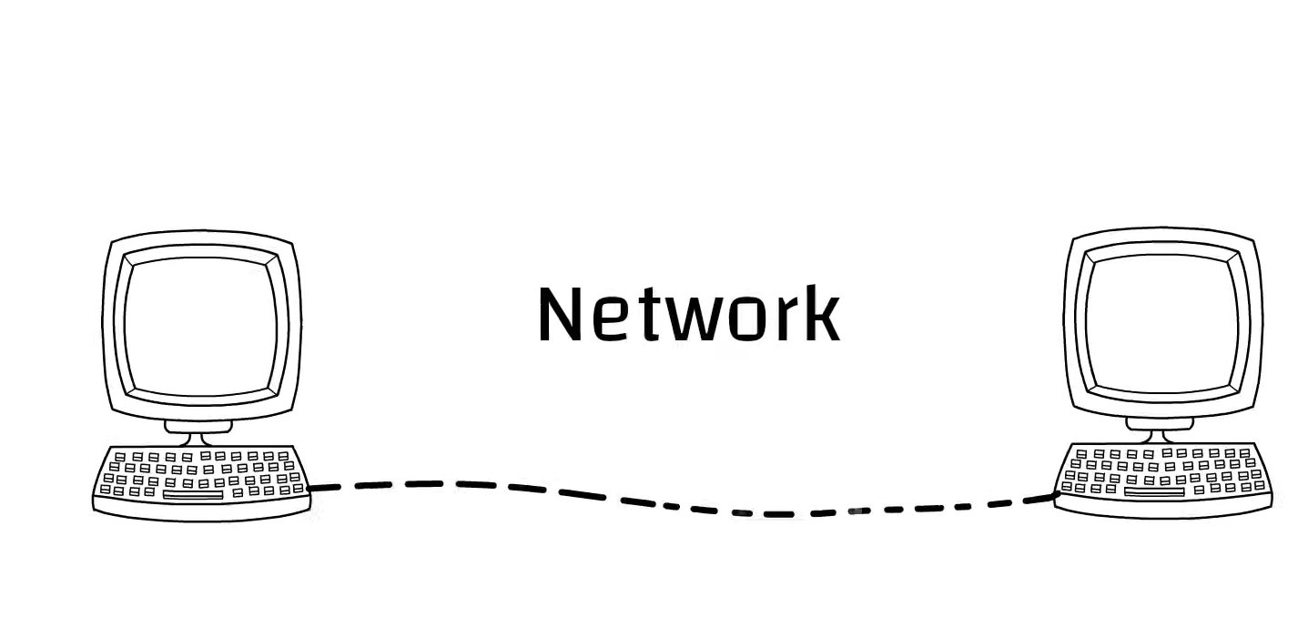
Two or more devices connect to form a network

Slide 3
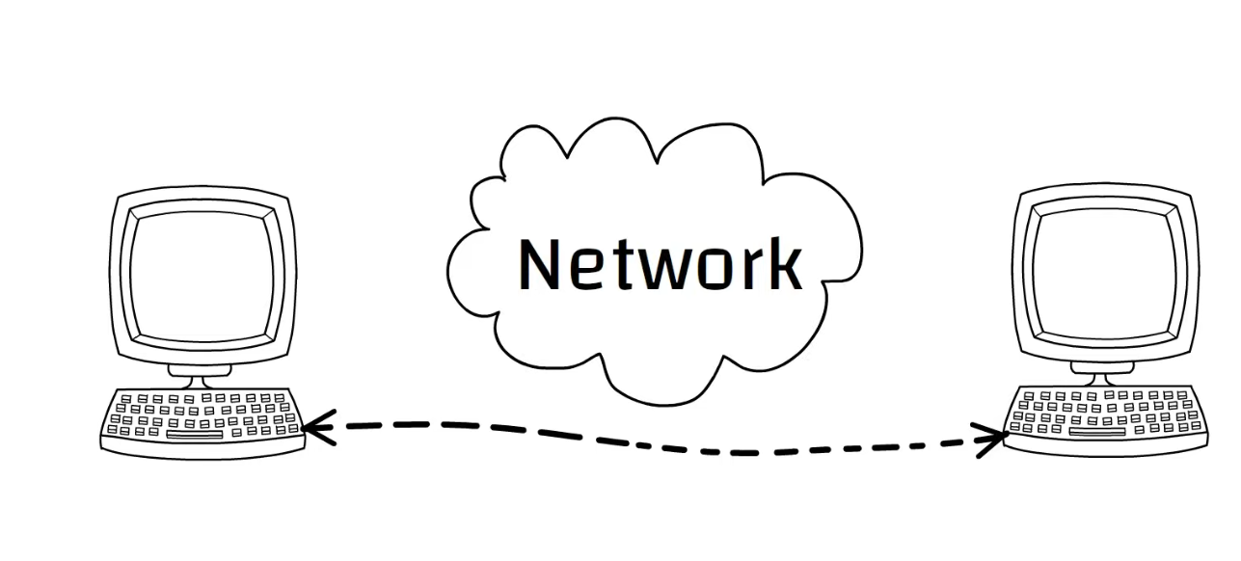
That devices communicate one to one communication

Slide 4
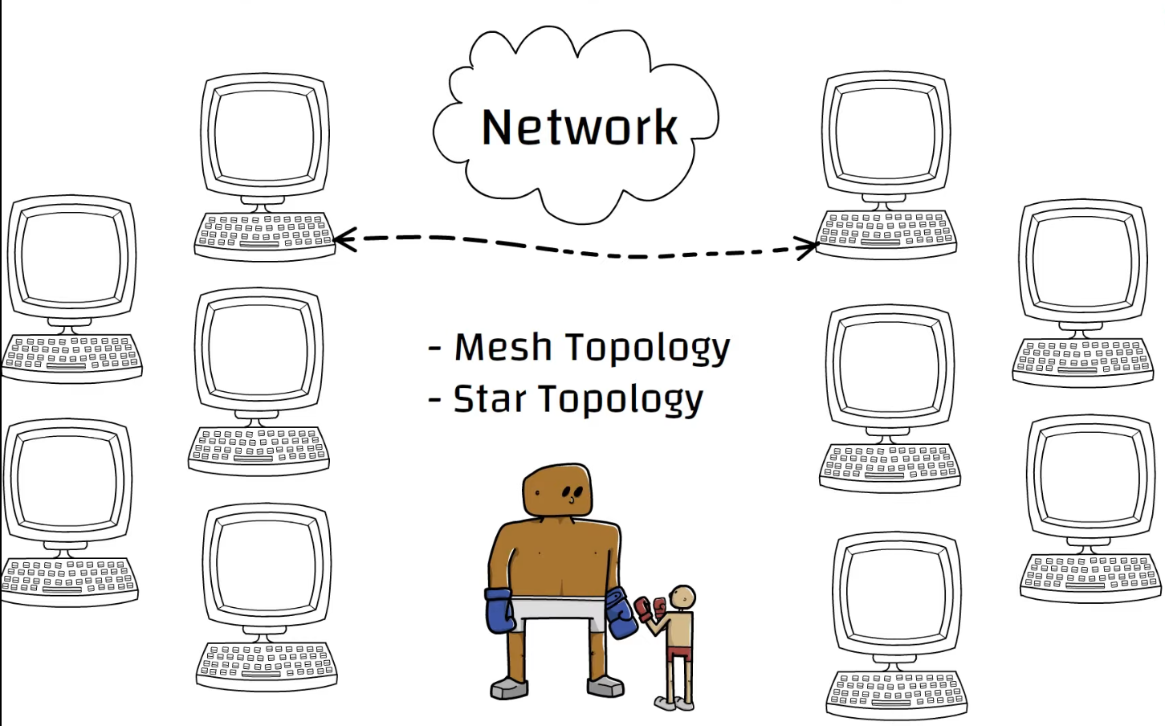
Topology is not impractical when the number of increased

Slide 5

Solution

Slide 6
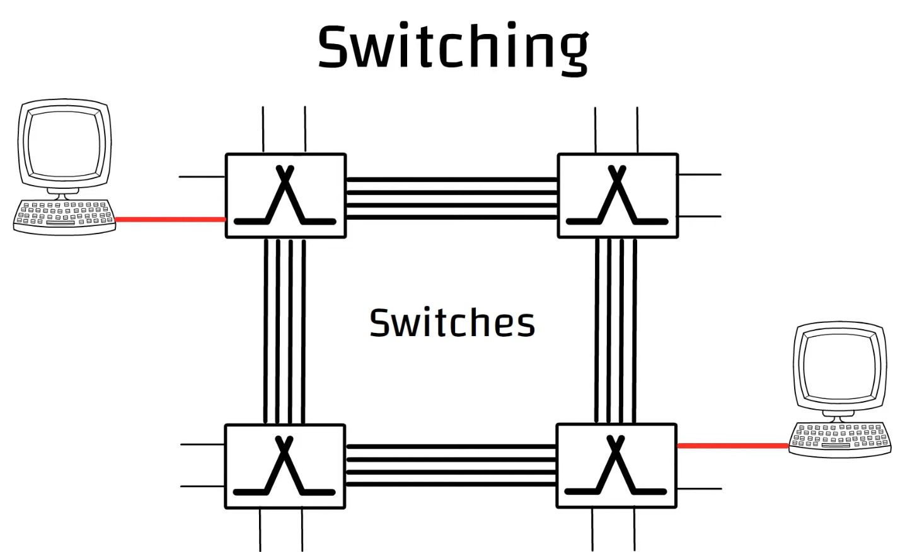
Is a devices where interlinked to each other are used to set up temporary point to point connections among the systems.
End systems connect directly to the switches.

Slide 7
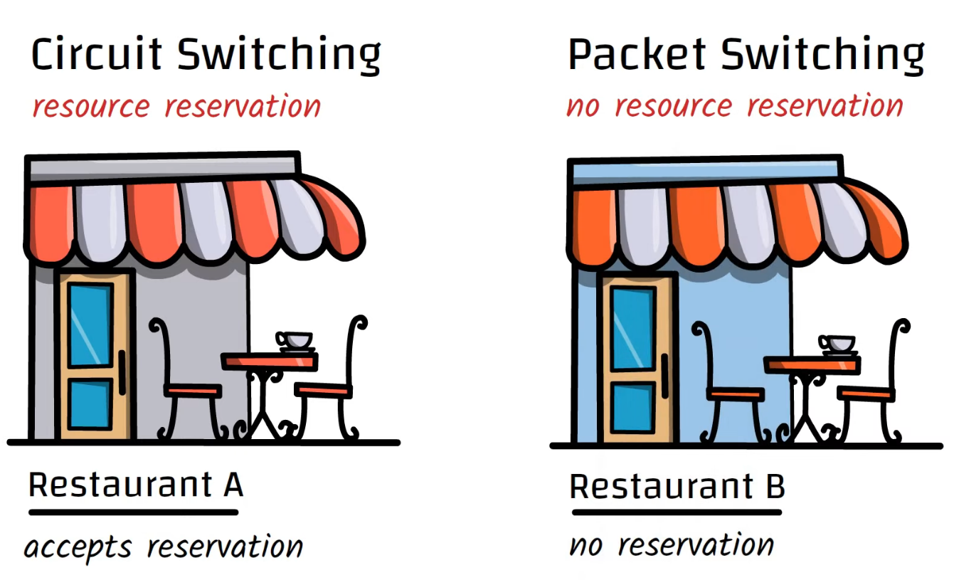
Resources are reserved for the communication session

Slide 8
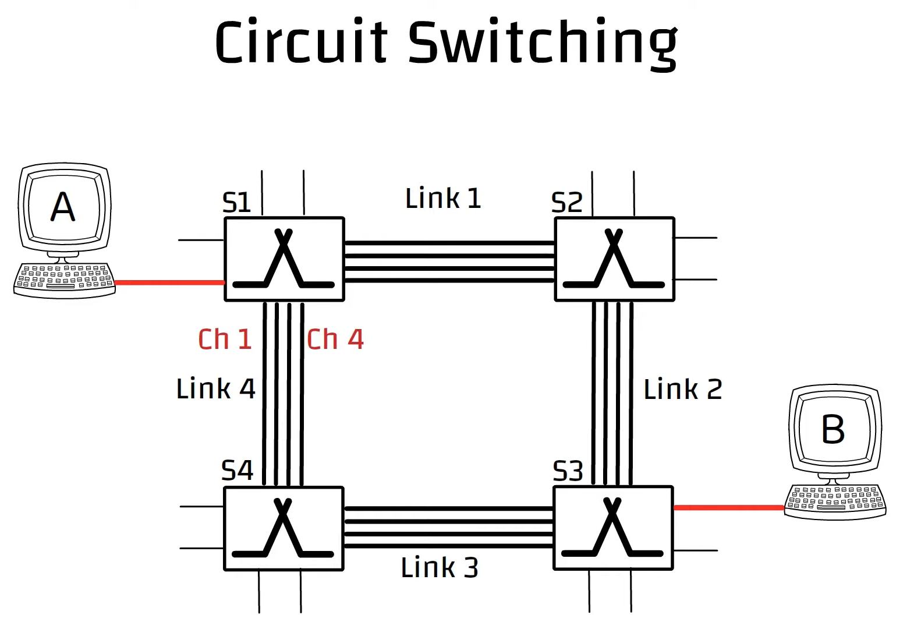
Four switches interlinked by four links
Each link has four connections or channel

Slide 9
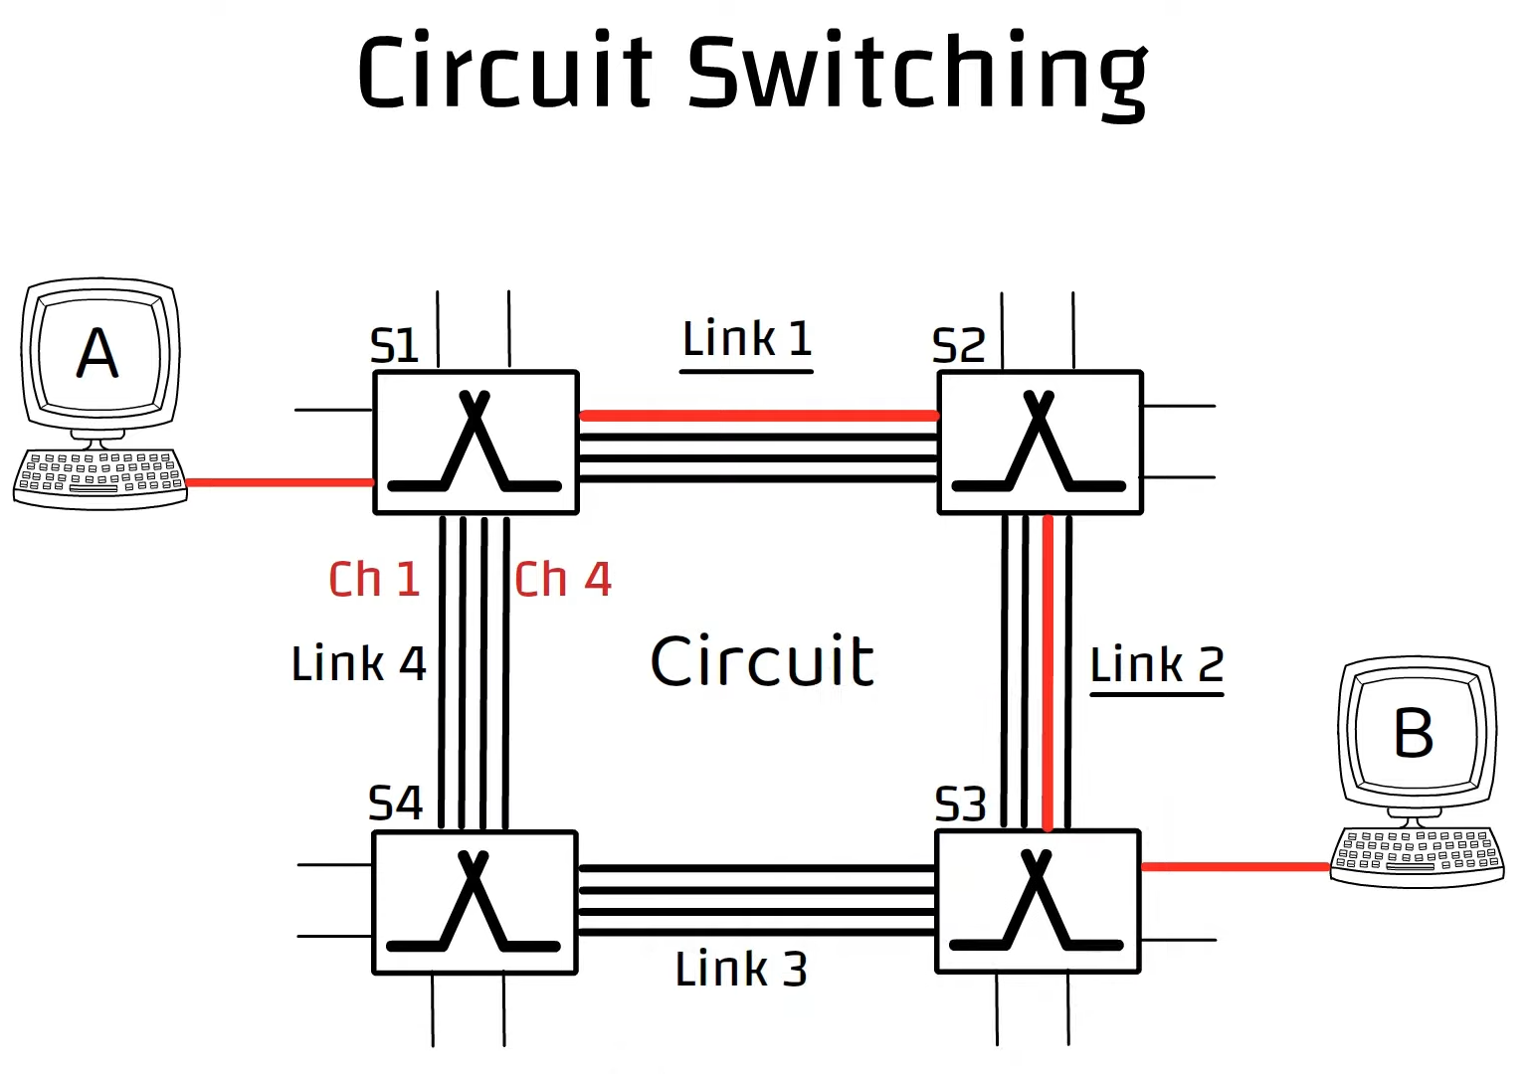
First and second links can say Link 1 and Link 2.
That Combination of channel is called circuit

Slide 10
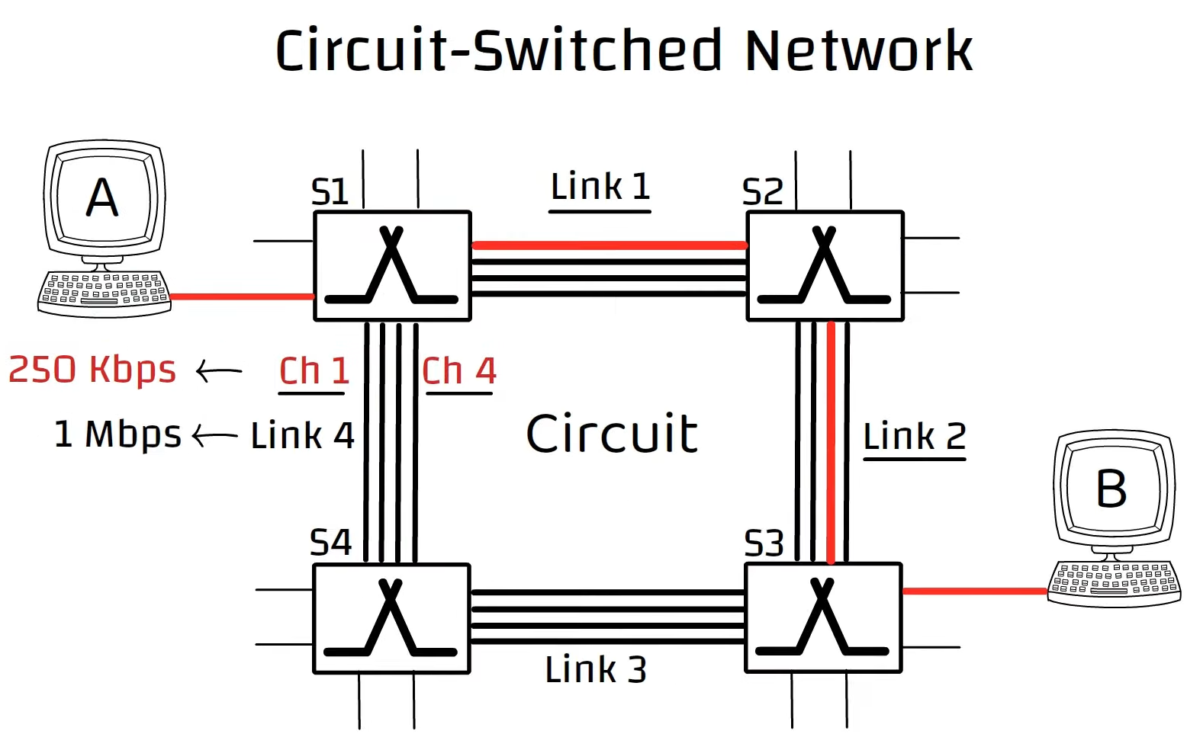
Circuit is set up b/w Host A and Host B.
Each link has transmission rate of 1 Mbps. And each link has 4 channel and transmission rate of 250 Kbps
Sender to receiver guaranteed constant transmission rate with the help of reserved sources is called circuit- switched network.

Slide 11
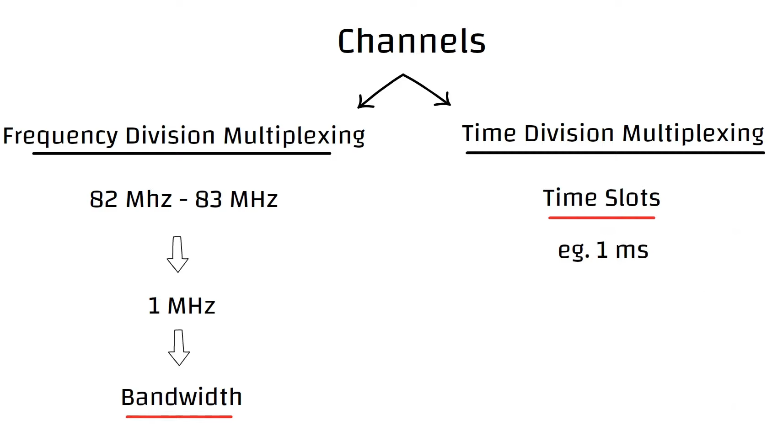
The channel are created with FDM and TDM

